Slide 1
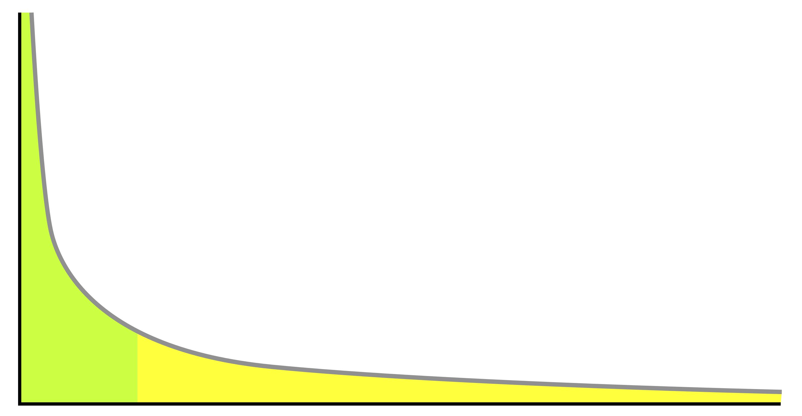
The Inevitable Problem of Rare Phenomena Learning in Machine Translation
Committee
Jonathan May (advisor)
Chris Mattmann
Xuezhe Ma
Aiichiro Nakano
Shri Narayanan
Xiang Ren
Dissertation Proposal
by
Thamme Gowda
Jan 25, 2022

Slide 2
75 Years Ago ….
“A most serious problem, for UNESCO and for the constructive and peaceful future of the planet, is the problem of translation, as it unavoidably affects the communication between peoples. ... I have wondered if it were unthinkable to design a computer which would translate.” – Warren Weaver, 1947^{[1]}
[1] https://aclanthology.org/www.mt-archive.info/Weaver-1949.pdf

Slide 3
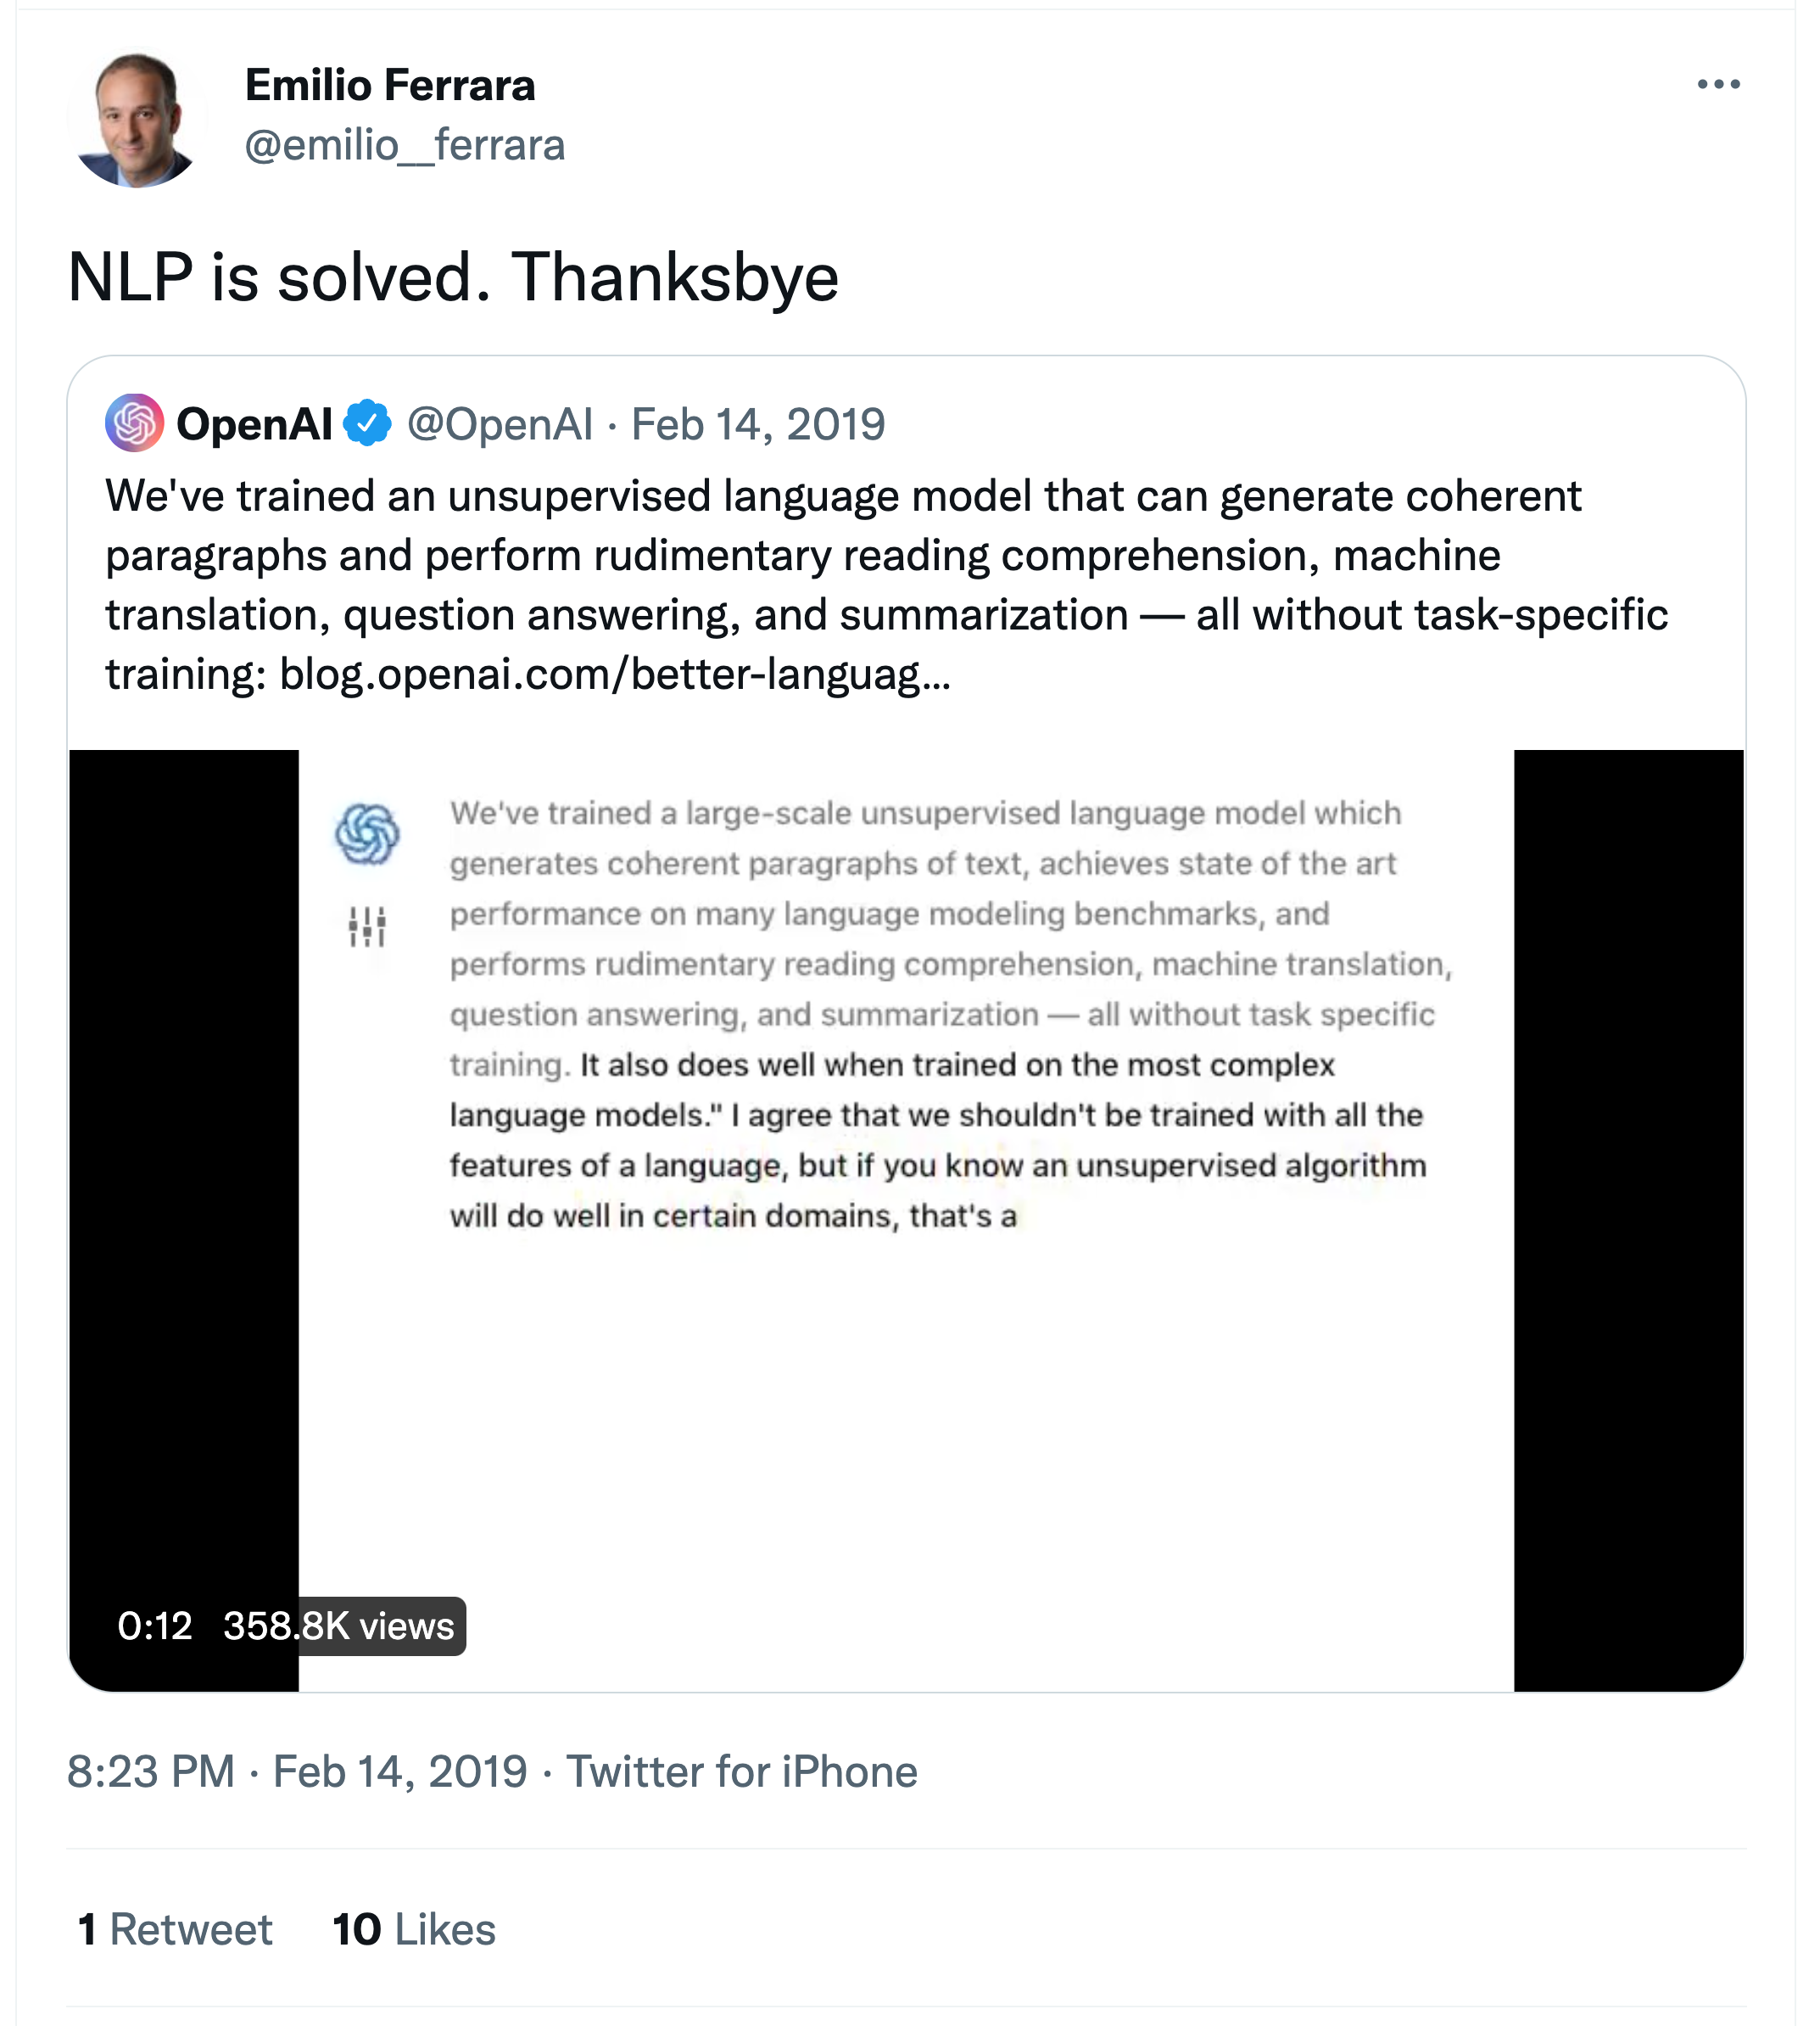
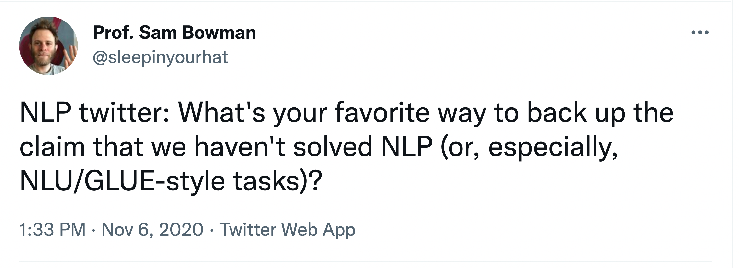
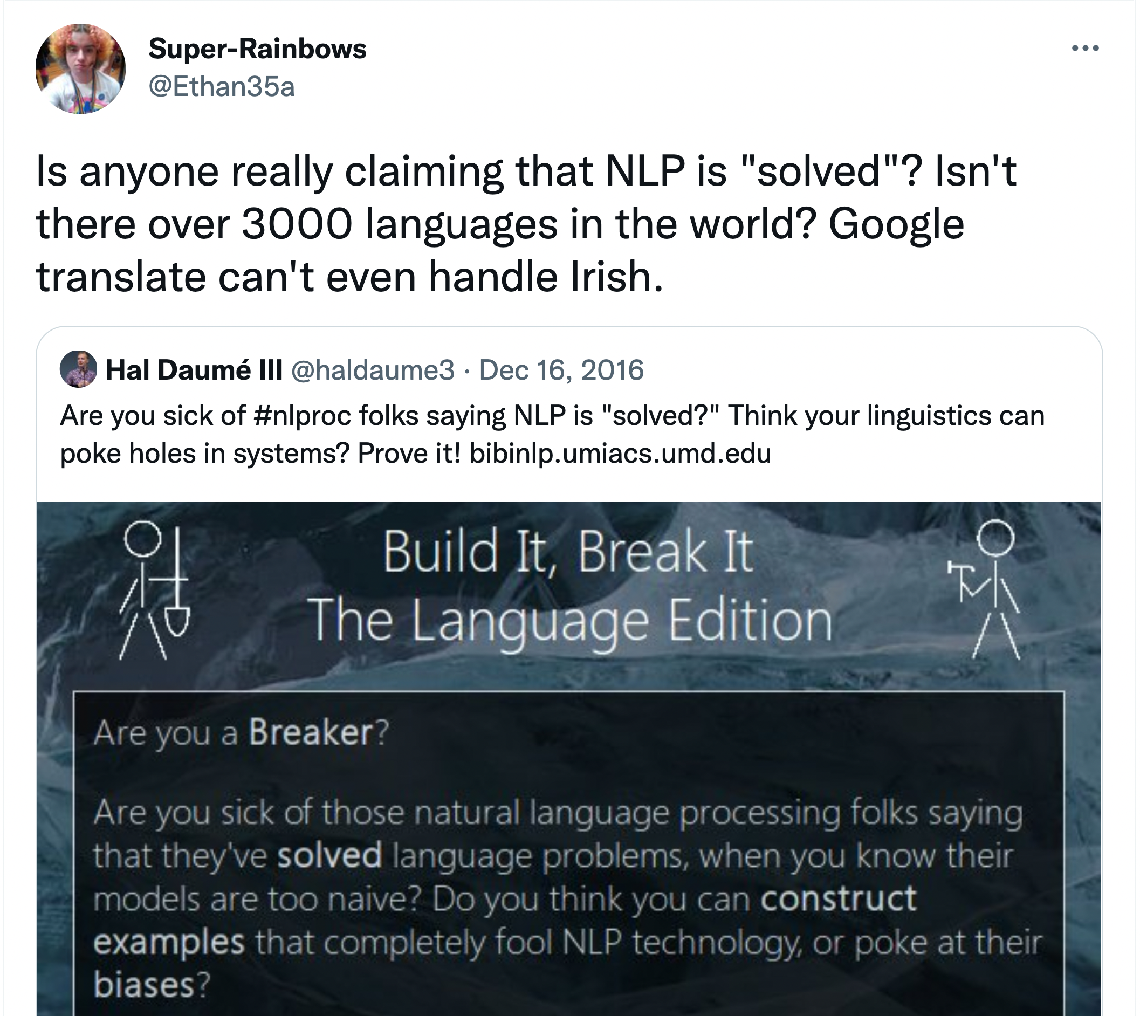
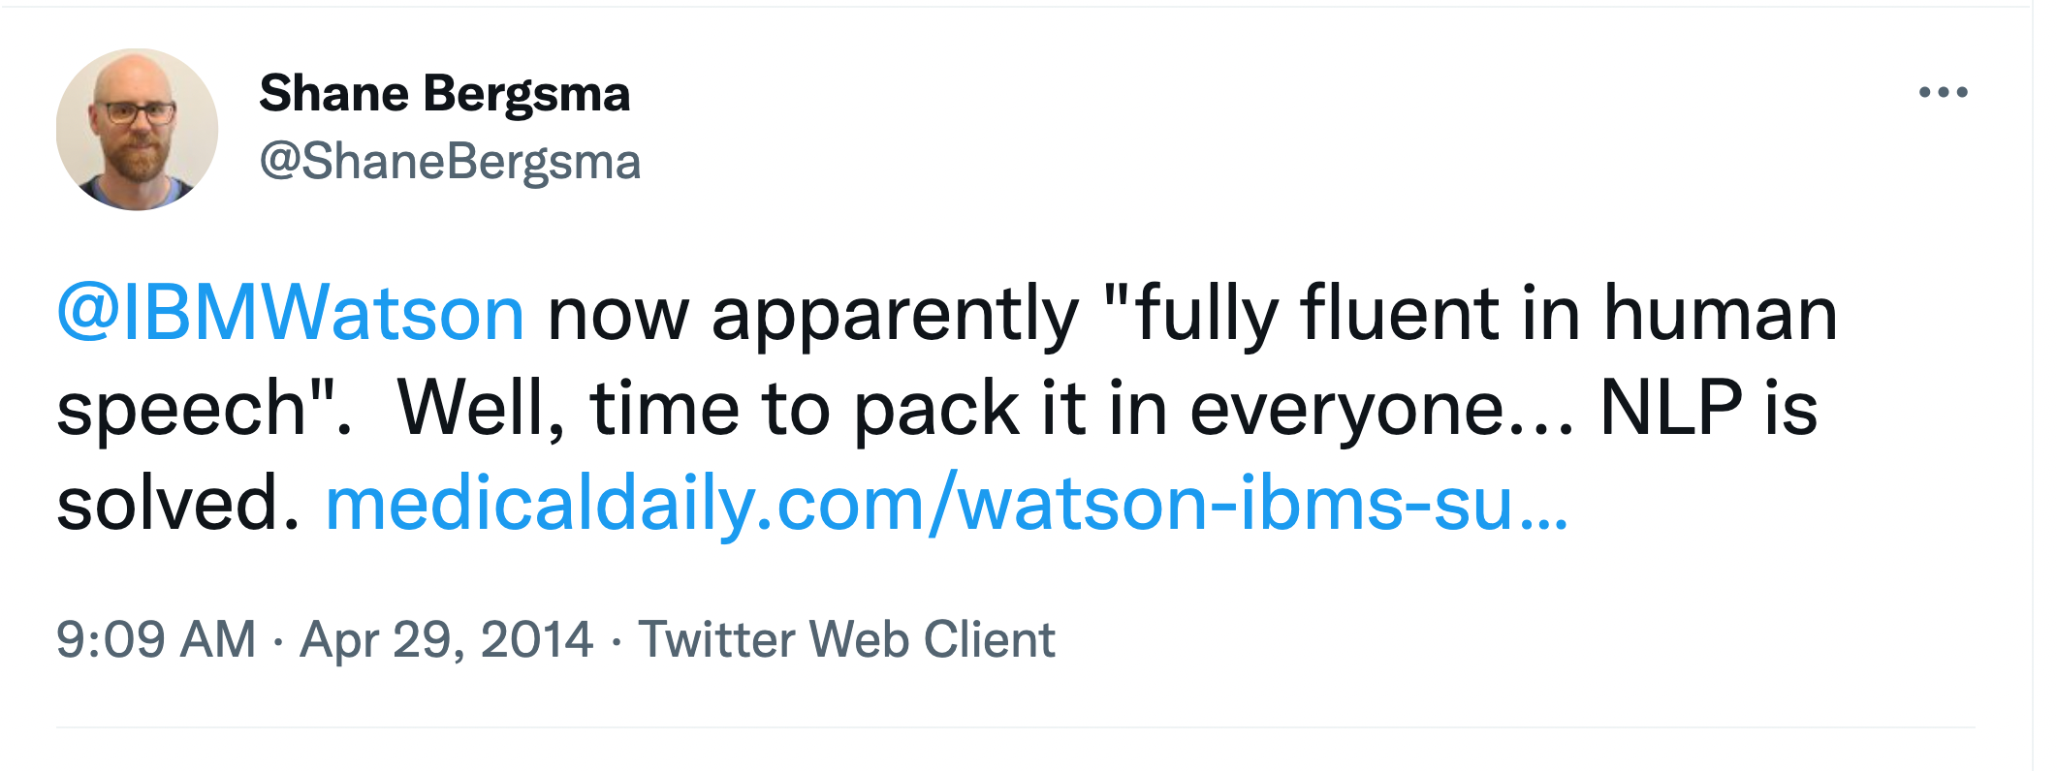
Is NLP/MT Solved Now?
1.
2.
Source: https://twitter.com/search?q=“NLP is solved”

Slide 4
“Zipf’s law says that most of the variance in language behavior can be captured by a small part of the system. ... Zipf’s law, also says that most of the information about the language system as a whole is in the Long Tail. ... the machine learning techniques that we rely on are actually very bad at inducing systems for which the crucial information is in rare events. One day, either because of the demise of Moore’s law, or simply because we have done all the easy stuff, the Long Tail will come back to haunt us.” – Mark Steedman, 2008^{[1]}
[1] https://aclanthology.org/J08-1008/

Slide 5
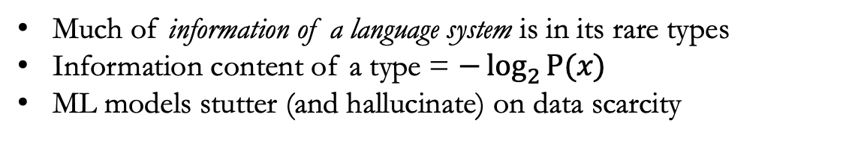
Long-tail Curse
Much of information of a language system is in its rare types
Information content of a type = $−\log_{2}{P(x)}$
ML models stutter (and hallucinate) on data scarcity
MT is not solved until we address the long-tail problem, e.g., rare words

Slide 6
Language Coverage
There are 7,000+ known living languages^{[1]}
But only about 100 languages are supported by popular MT
Google Translate^{[2]}: 108; Microsoft Translate^{[3]}: 103
Much of research efforts are also limited to the top 100 languages
MT models are unavailable for many languages
[1] Ethnologue: Languages of the World. http://www.ethnologue.com [2] https://blog.google/products/translate/five-new-languages/ [3] https:/www.microsoft.com/en-us/research/blog/microsoft-translator-now-translating-100-languages-and-counting/

Slide 7
TG’s Thesis
Rare phenomena learning is inevitable in machine translation (MT)
It manifests in various forms
Rare words
At training time → Mitigate the imbalance in word type distributions
At evaluation time → Recognize the importance of rare words
Rare languages → Support low-resource languages
Rare phrases → Improve robustness
Until we address these challenges, MT is far from being solved

Slide 8
Progress: Dealing with Rare Phenomena in MT
I – Rare words in Training
II – Rare words in Evaluation
III – Rare Languages (500+ languages)
“Many-to-English MT Tools, Data, and Pretrained Models” [ACL 2021 Demos]
“Macro-Average: Rare Types are Important Too” [NAACL 2021]
“Finding the Optimal Vocabulary Size for NMT” [EMNLP 2020 Findings]
IV – Robustness / Language Switching
“Improving Robustness in MT via Data Augmentation” [Under review/NAACL22]

Slide 9
Implications: Look Ahead
 | Before/Now | After/End of the Presentation
NMT | NMT is generation | NMT is classification^{[1]}
Vocabulary Size | Arbitrary hyperparameter | Well reasoned parameter; chosen using a heuristic ^{[1]}
Evaluation | Treat each ‘token/instance’ equally | Important tokens are treated more important^{[2]}
Scaling NMT | To ~100 languages | To ~500 languages; Bunch of useful tools^{[3]}
Multilingual NMT robustness | Not robust | Robust to language switching ^{[4]}
[1] Gowda and May, ‘Finding the optimal vocabulary size for NMT’, EMNLP 2020 Findings
[2] Gowda et al, ‘Macro-average: Rare types are important too’, NAACL 2021
[3] Gowda et al, ‘Many-to-English tools, data, and pretrained models’, ACL 2021 Demos [4] Gowda et al, ‘Improving multilingual MT robustness via data augmentation, [under review/NAACL2022]
TG's Dissertation Proposal

Slide 10
Co-Authors
Jonathan May, USC ISI (+advisor+committee)
Chris Mattamann, USC & JPL (+committee)
Mozhdeh Gheini, USC ISI
Zhao Zhang, UT & JPL
Weiqiu You, U Penn
Constantine Lignos, Brandeis University
Collaborators/Special Thanks
Scott Miller, USC ISI
Shantanu Agarwal, USC ISI
Joel Barry, USC ISI
Committee Members
Xuezhe Ma
Shri Narayanan
Aiichiro Nakano
Xiang Ren
Acknowledgments
USC Employee Benefits (Tuition Assistance)
DARPA LORELEI
IARPA MATERIAL
DARPA LwLL
Computing Resources
USC Center for Advanced Research Computing (CARC)
Texas Advanced Computing Center (TACC)

Slide 11
Part-I Rare Words in Training
Finding the Optimal Vocabulary Size for NMT
EMNLP Findings 2020
Thamme Gowda and Jonathan May
https://aclanthology.org/2020.findings-emnlp.352/

Slide 12
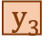

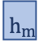
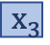
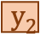
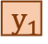
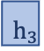
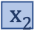
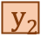
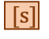
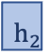
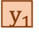
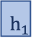
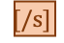

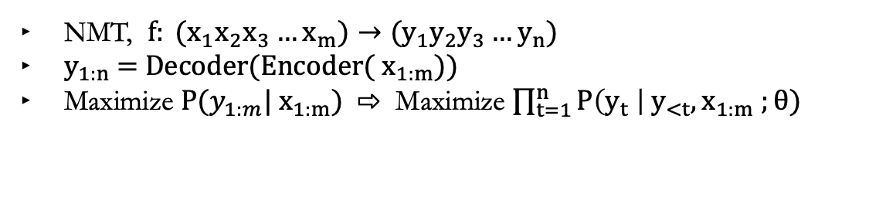
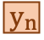
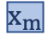
Neural Machine Translation
NMT, $f: (x_{1}x_{2}x_{3}…x_{m})→{(y}_{1}y_{2}y_{3}…y_{n})$
$y_{1:n}$= Decoder(Encoder(${ x}_{1:m}$))
Maximize $P({y_{1:m}| x}_{1:m})$ ⇨ Maximize $\prod_{t=1}^{n}{P\left(y_{t} \right| y_{<t}, x_{1:m} ;θ)}$
RNN LSTM, GRU
Bi RNN
+Attn
CNN
- RNN -Bottleneck
Transformer RNN, CNN +FF +SelfAttn
$$y_{1}$$
$$y_{2}$$
$$y_{3}$$
…
$$[/s]$$
DECODER
$$h_{1}$$
$$h_{2}$$
$$h_{3}$$
…
$$h_{m}$$
$$h_{s}$$
Cross-Attention
Self Attn
ENCODER
Self Attn
Self Attn
$[s]$
$$y_{1}$$
$$y_{2}$$
…
$$y_{n}$$
$$x_{1}$$
$$x_{2}$$
$$x_{3}$$
…
$$x_{m}$$

Slide 13
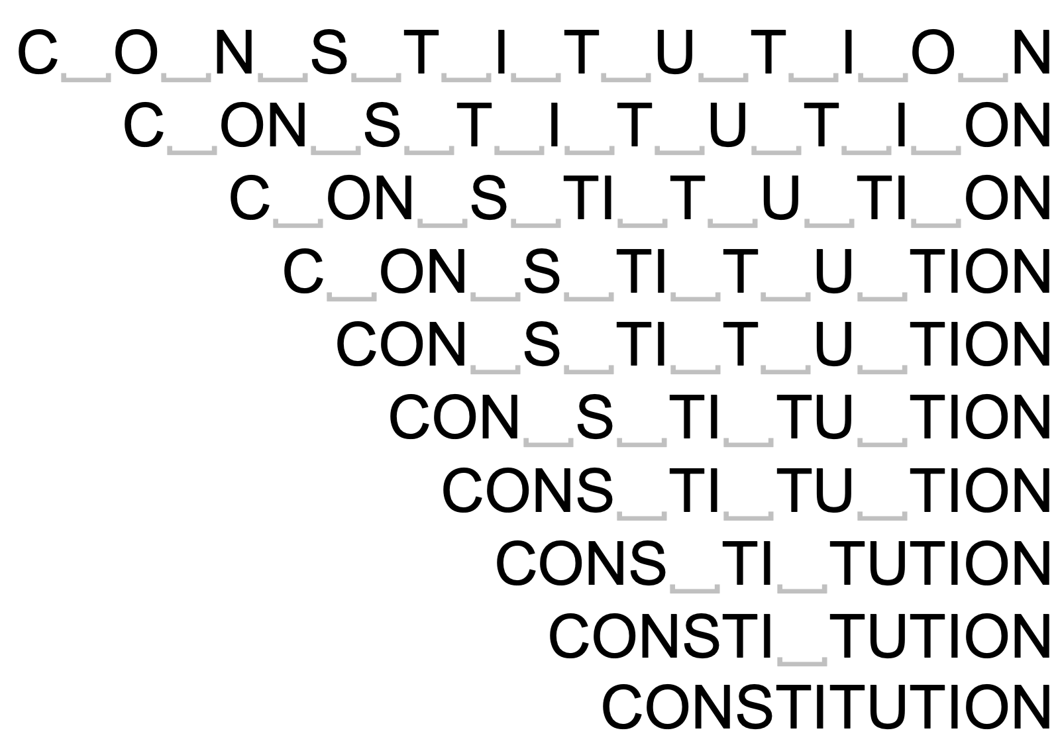
BPE Subwords
Out-of-vocabulary/UNK words used to be a hard problem in MT
Byte-pair-encoding sub words ➔ addresses open-vocabulary generation [Sennrich et al 2016^{[1]}] ➔ gets better performance than chars and words
Subwords are obtained by merging most frequent chars and subwords
Number of merges is a hyper parameter
Why are some vocabulary sizes better than others?
WORD ⇦BPE ⇨ CHARS
[1] https://aclanthology.org/P16-1162/
Notes:
Why are some vocabulary sizes better than others?
We didn’t know – If we try to find answer to this question, we end up going in a rabit hole and will find answer to the question about data imbalance

Slide 14
Experimental Setup
Four target languages: DE→EN, EN→DE, EN→HI, and EN→LI
Total of 11 dataset sizes: between 30K and 4.5M sentences
x 10 vocabulary sizes: Chars, 500, 1K, 2K, 4K, 8K, 16K, 32K, 48K, and 64K
Transformer with 6 layers, 512 dims, 8 attn heads, 0.1 dropout, …
Adam optimizer; 16,000 warmup steps followed by inverted sqrt decay; training stops when the validation loss start to climb up
Beam decoder, length penalty, checkpoint averaging …
Separate vocabs for source and target Decoder’s input and output embeddings are tied

Slide 18
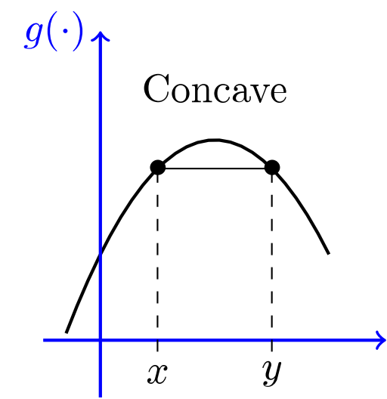

Why are all BLEU lines (sort of) concave down on vocabulary size?

Slide 19
Transformer Ablation
Hypothesis: Encoder is not a must have, but rather a good to have component
Varying number of layers; DE→EN (shared vocab) and EN→HI (separate vocab)
No encoder layers!
Most people do not listen with the intent to understand; they listen with the intent to reply. – Stephen Covey, 2004

Slide 20
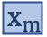
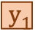
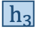
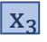
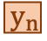
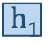
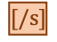
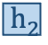
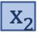
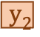

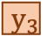
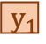
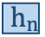
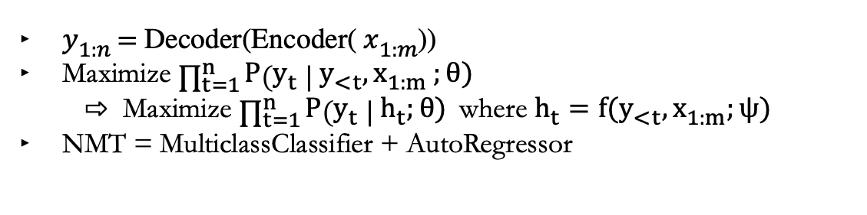
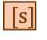
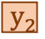
NMT Abstraction
$y_{1:n}$= Decoder(Encoder(${ x}_{1:m}$))
Maximize $\prod_{t=1}^{n}{P\left(y_{t} \right| y_{<t}, x_{1:m} ;θ)}$ ⇨ Maximize $\prod_{t=1}^{n}{P\left(y_{t} \right| h_{t};θ)}$where $h_{t}=f(y_{<t}, x_{1:m};ψ)$
NMT = MulticlassClassifier + AutoRegressor
$$y_{1}$$
$$y_{2}$$
$$y_{3}$$
…
$$[/s]$$
MULTICLASS CLASSIFIER
$$h_{1}$$
$$h_{2}$$
$$h_{3}$$
$$h_{n}$$
Cross-Attention
AUTOREGRESSOR
Encoder
Self-Attention
$$x_{1}$$
$$x_{2}$$
$$x_{3}$$
…
$$x_{m}$$
$$[s]$$
$$y_{1}$$
$$y_{2}$$
…
$$y_{n}$$
High-level abstraction of Transformer NMT
Notes:
Deep Learning book by Ian Goodfellow, Chapter (15) on Representation Learning
Last layer is linear classifier. Autoregressor learns representations

Slide 21
Imbalanced Classification Problem
Classification problem: output variable is discrete e.g., classes, word types
Imbalanced : unequal frequency distribution i.e., some classes are frequent → majority class(es) and others are rare → minority class(es)
Examples
Cancer detection: fewer positive labels than negative
Image segmentation: “background pixel” is more prevalent than foregrounds
NLP: stopword types have more tokens than content word types
Problem: Frequency based biases degrades overall performance
Minority classes are ignored → poor recall
Special care is required during evaluation → the topic for Part-II
Imbalanced Learning: Byte pair encoding (BPE): Balances classes via splitting and merging
➔ Tuning the vocabulary size improves class balance ✅

Slide 22
Imbalanced Classification Learning Methods
Sampling methods:
(1) Up-sampling /over-sampling (2) Down-sampling / under-sampling, (3) Synthetic Minority Over-sampling (SMOTE) ➔ Not straight forward in MT; word types are imbalanced, but sentences are to be sampled
Weighted loss functions:
Weighted cross entropy
Focal-loss
Effective number of samples
Adaptive learning methods, e.g., ADAM, and label smoothing achieve a similar effect
Byte Pair Encoding (BPE) Balancing classes via splitting and merging in a sequence
➔ Tuning the vocabulary size improves class balance ✅

Slide 23
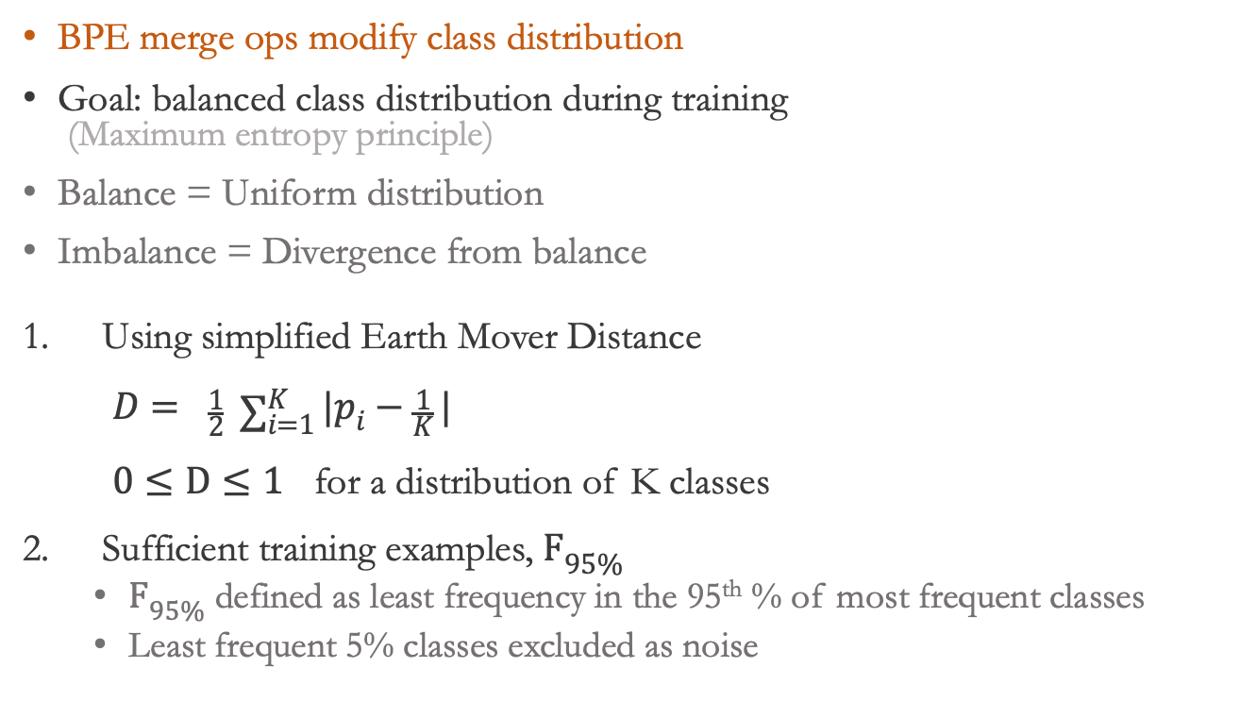
Classifier (C)
BPE merge ops modify class distribution
Goal: balanced class distribution during training (Maximum entropy principle)
Balance = Uniform distribution
Imbalance = Divergence from balance
Using simplified Earth Mover Distance $D= \frac{1}{2} \sum_{i=1}^{K}{|p_{i}−\frac{1}{K}|}$ $0≤D≤1$ for a distribution of K classes
Sufficient training examples, $F_{95\%}$
$F_{95\%}$ defined as least frequency in the 95th % of most frequent classes
Least frequent 5% classes excluded as noise

Slide 24
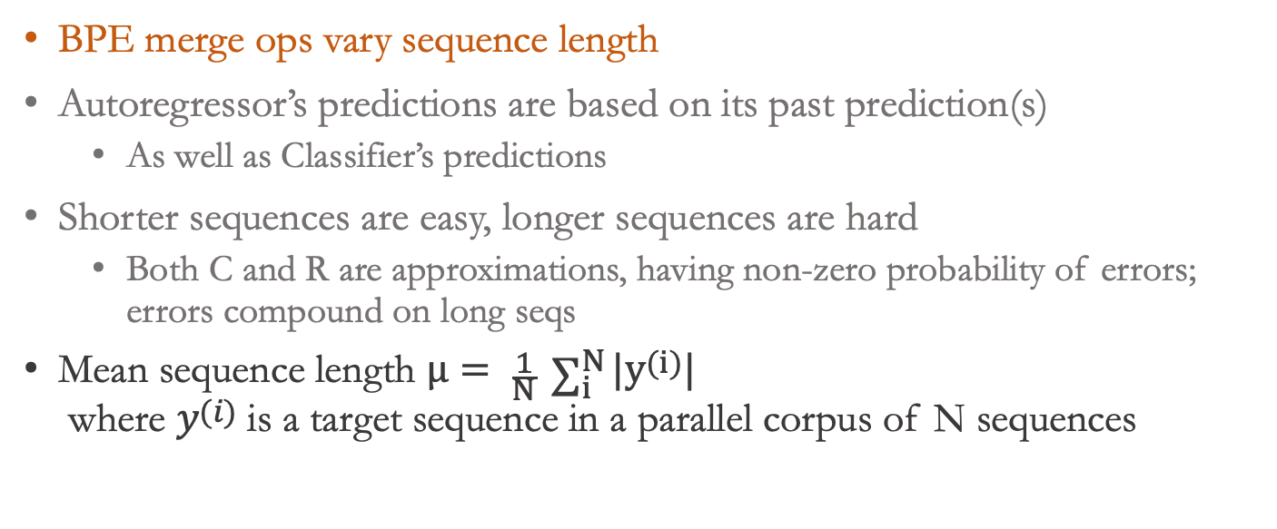
AutoRegressor (R)
BPE merge ops vary sequence length
Autoregressor’s predictions are based on its past prediction(s)
As well as Classifier’s predictions
Shorter sequences are easy, longer sequences are hard
Both C and R are approximations, having non-zero probability of errors; errors compound on long seqs
Mean sequence length $μ= \frac{1}{N} \sum_{i}^{N}{{|y}^{(i)}|}$ where $y^{(i)}$ is a target sequence in a parallel corpus of N sequences

Slide 25
Effect of BPE
As BPE merge operations increase
Sentence length decreases
Class imbalance increases*
We need both shorter sequences and smaller imbalance values ⇨
Left: balanced but long
Right: short but imbalanced
Best vocab size is the one that reaches a good trade-off

Slide 26
Heuristic
“Use the largest possible BPE vocabulary such that at least 95% of classes have about 100 or more training examples”

Slide 27
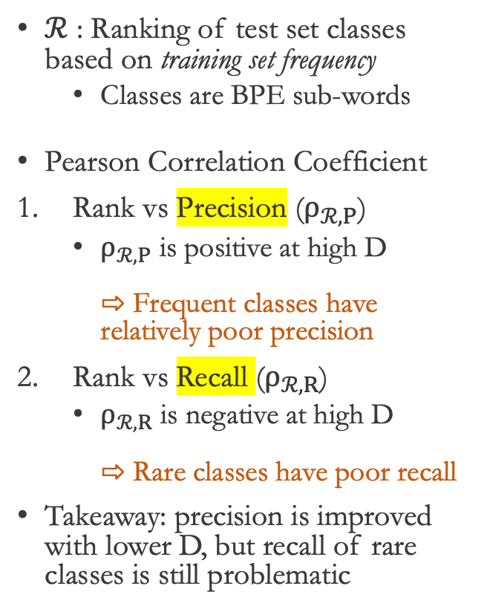
Frequency-based Bias on Class Performance
$ℛ$ : Ranking of test set classes based on training set frequency
Classes are BPE sub-words
Pearson Correlation Coefficient
Rank vs Precision ($ρ_{ℛ,P}$)
$ρ_{ℛ,P}$ is positive at high D ⇨ Frequent classes have relatively poor precision
Rank vs Recall ($ρ_{ℛ,R}$)
$ρ_{ℛ,R}$ is negative at high D ⇨ Rare classes have poor recall
Takeaway: precision is improved with lower D, but recall of rare classes is still problematic

Slide 28
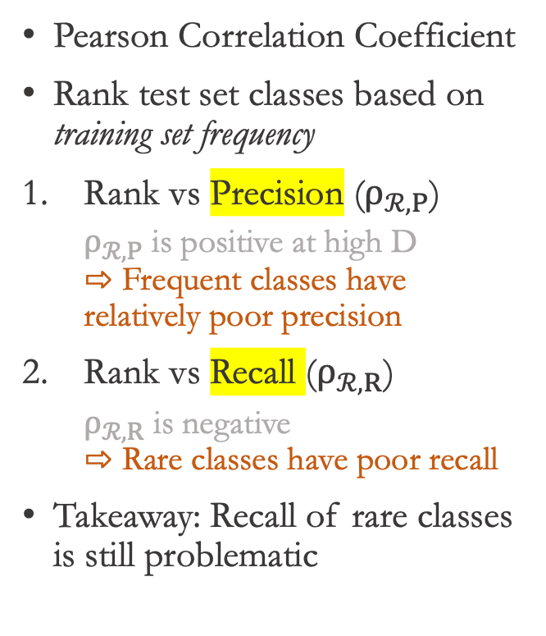
Frequency-based Bias on Class Performance
Pearson Correlation Coefficient
Rank test set classes based on training set frequency
Rank vs Precision ($ρ_{ℛ,P}$)
$ρ_{ℛ,P}$ is positive at high D ⇨ Frequent classes have relatively poor precision
Rank vs Recall ($ρ_{ℛ,R}$)
$ρ_{ℛ,R}$ is negative ⇨ Rare classes have poor recall
Takeaway: Recall of rare classes is still problematic

Slide 29
Part-I Conclusion
Related Work
Summary
Imbalance is unavoidable in natural language generation datasets
We can split [or merge sub-]words, which is effective to handle imbalance
One of the reasons why byte-pair-encoding/sub-words is very effective in NMT
NMT models have frequency-based biases
Rare types have lower recall than frequent types
Others have focused on ways to search vocabulary size
we have given explanation for why some sizes are better than others, in addition to a heuristic
No other work showing frequency-based biases in NMT

Slide 30
Part-II Rare Words at Evaluation
All words
are important,
but
some words are
more important than others.
Macro-Average: Rare Types are Important Too
NAACL 2021
Thamme Gowda, Weiqiu You, Constantine Lignos, and Jonathan May
https://aclanthology.org/2021.naacl-main.90/

Slide 31
Motivation / Problem
Natural language datasets have imbalanced word types
ML techniques, including NMT, suffer from class imbalance
Poor recall for rare types
Rare types have more information content
Extra care is required, otherwise, metrics give a false sense of confidence on model performance
E.g., cancer detection with 1:99 imbalance; majority label classifier gets 99% overall accuracy, but that’s not a useful metric
Same is true for NLP
Frequencies are from Brown Corpus (English) ~1.2M tokens, ~48k types
- log₂ P(x)
P(x)
Notes:
We have imbalanced types
ML techniques we use (say classifiers), they suffer from data imbalance and scarcity
If frequent types are the ones we care, then we are in luck..
But the rare types are important
So, we need extra care while applying ML on this distribution
In our past work, we showed how certain hyper params such as BPE vocabulary influence imbalance, and showed frequency based biases that exist in NMT models
In this work, we focus on evaluation

Slide 32
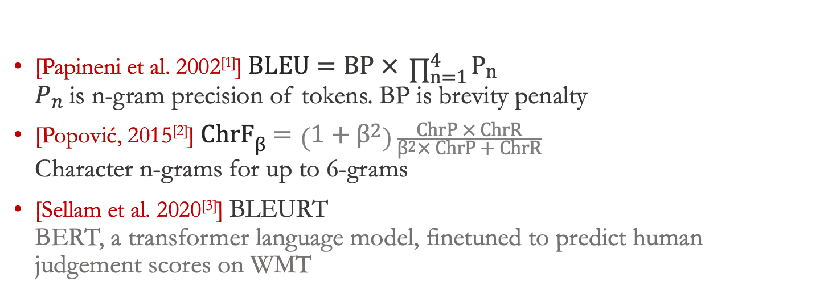
Review of MT Metrics
[Papineni et al. 2002^{[1]}] $BLEU=BP × \prod_{n=1}^{4}{P_{n}}$ $P_{n}$ is n-gram precision of tokens. BP is brevity penalty
[Popović, 2015^{[2]}] $ChrF_{β}=\left(1+β^{2}\right)\frac{ChrP × ChrR}{β^{2}× ChrP + ChrR}$ Character n-grams for up to 6-grams
[Sellam et al. 2020^{[3]}] BLEURT BERT, a transformer language model, finetuned to predict human judgement scores on WMT
[1] https://aclanthology.org/P02-1040/ [2] https://aclanthology.org/W15-3049/ [3] https://aclanthology.org/2020.acl-main.704/

Slide 33
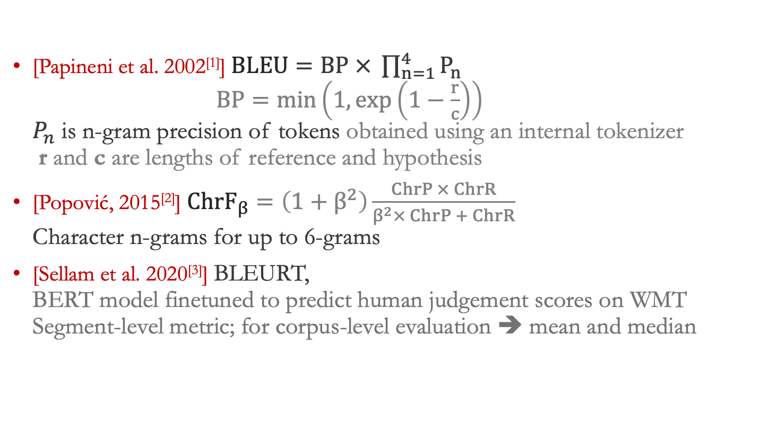
Review of MT Metrics
[Papineni et al. 2002^{[1]}] $BLEU=BP × \prod_{n=1}^{4}{P_{n}}$ $BP=\min\left(1,\exp\left(1−\frac{r}{c}\right)\right)$ $P_{n}$ is n-gram precision of tokens obtained using an internal tokenizer r and c are lengths of reference and hypothesis
[Popović, 2015^{[2]}] $ChrF_{β}=\left(1+β^{2}\right)\frac{ChrP × ChrR}{β^{2}× ChrP + ChrR}$ Character n-grams for up to 6-grams
[Sellam et al. 2020^{[3]}] BLEURT, BERT model finetuned to predict human judgement scores on WMT Segment-level metric; for corpus-level evaluation ➔ mean and median
[1] https://aclanthology.org/P02-1040/ [2] https://aclanthology.org/W15-3049/ [3] https://aclanthology.org/2020.acl-main.704/

Slide 34
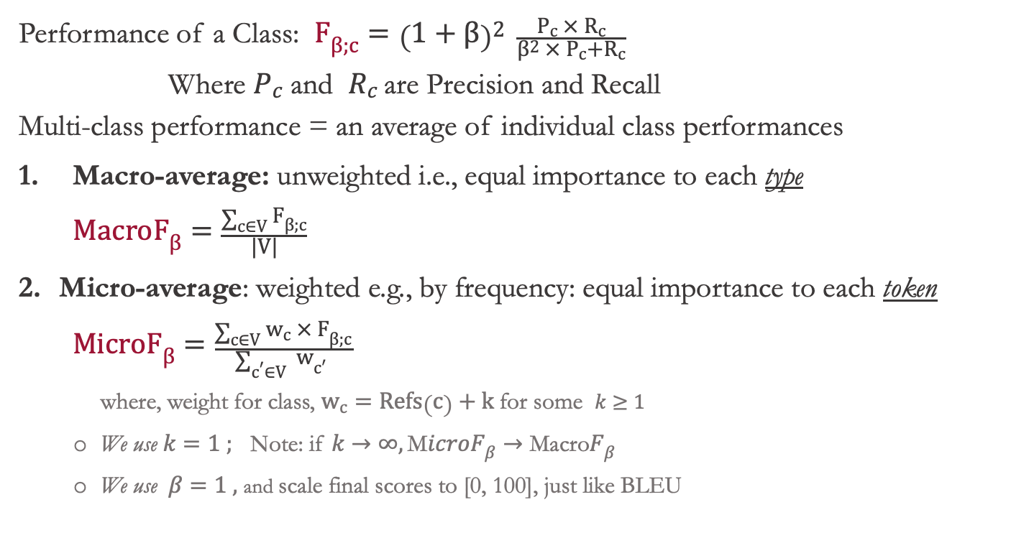
Multiclass Classifier Evaluation
Performance of a Class: $F_{β;c}={\left(1+β\right)}^{2} \frac{P_{c} × R_{c}}{β^{2} ×{ P}_{c}+R_{c}}$ Where $P_{c}$ and $R_{c}$are Precision and Recall Multi-class performance = an average of individual class performances
Macro-average: unweighted i.e., equal importance to each type $\text{Macro}F_{β}=\frac{\sum_{c∈V}{F_{β;c}}}{|V|}$
Micro-average: weighted e.g., by frequency: equal importance to each token $\text{M}icroF_{β}=\frac{\sum_{c∈V}{w_{c} × F_{β;c}}}{\sum_{c^{′}∈V}{ w_{c′} }}$
where, weight for class, $w_{c}=Refs\left(c\right)+k$ for some $k≥1$
We use $k=1 ;$ Note: if $k→∞, \text{M}icroF_{β}→\text{Macro}F_{β}$
We use $β=1 ,$ and scale final scores to [0, 100], just like BLEU
NOTE: Micro-F1 ≅ Accuracy
Notes:
So far, we have F-measure for each type, how do we summarize it to a single number?
We take an average over all types – but how do we average, this is where crucial detail is
We have two options:
First, an unweighted average aka macro average, in this case, we assign equal weight to each type.
Second, we have weighted average aka micro average. In this case, we pick frequencies in the reference side as weight... that's roughly equivalent to treating each token equally.
BLEU, for instance is precision metric -- what kind of precision ? it is Micro-averaged precision

Slide 35
MacroF1 vs Others
Frequency in test reference
Metric score % lost due to zero recall (same for zero precision)
Equal weight
MacroF1 has equal weight for all types (WMT 19 DE-EN NewsTest)
Micro-averaged metrics overlook improvements from rare types, after rounding to one or two decimals
Notes:
Before we go into details, here is how macro-average is different than the rest. What are we visualizing here ? We replaced types with an OOV type of same number of chars (same chars so length penalty is not in effect), and computed the drop in corpus level score. That’s a proxy for maximum reward a metric offer for correctly learning to translate a type.
Also showing frequencies in the blue line in top. we see --
MicroF1 treats each token equally – so MicroF1 in purple is roughly resembling the shape of frequency
MacroF1 assigns equal weight to each type – so we see a horizontal line in orange.
BLEU and CHRF are more like MicroF than MacroF. They have spikes and surges because of different number n-grams affected by each type. BLEURT scores are not in an interpretable range. So not shown here.
The takeaway is -- the reward from micro-averaged metrics for rare words is in two to three decimal points
Since we generally round the corpus score to just one decimal point, there is a good chance that gain from rare types are easily overlooked

Slide 36
Empirical Justification for MacroF1 as an MT Eval Metric
Compare MacroF1 with
BLEU and ChrF1
MicroF1 – so we can see the difference micro and macro avg makes
BLEURT – model-based metric based on BERT
BLEURT has undesirable biases, shown in paper (not talking about here)
On these tasks:
Machine Translation: direct human assessment: WMT Metrics 2017-19 MT vs Human judgement score correlations
Downstream CLIR Task metrics: CLSSTS 2020 MT vs IR score correlations
Data-to-text: Fluency and Semantics: WebNLG
MacroF1 as ASR metric correlation with IR metrics: (IARPA MATERIAL program)
Not talked here
Notes:
Will this simple metric work for MT evaluation? We shall do a comparison

Slide 37
WMT Metrics: Wins per Metric
Wins = Number of times a metric scored highest correlation with human judgements
*BLEU is from the WMT metrics package, precomputed by task organizers
MacroF1 and MicroF1 use the same tokenizer as BLEU, obtained using SacreBLEU
MacroF1 has more wins in the recent year -- when systems are mostly fluent, adequacy is a key discriminator
Notes:
*BLEU is from the metrics package, precomputed by task organizers
BLEU is our own calculations. MacroF1 and MicroF1 share the same tokenizer as BLEU

Slide 38
CLIR Task: Pipeline
CLSSTS 2020 / IARPA MATERIAL IR task with queries and docs in different languages
Build a set of MT models; translate all source documents to the target language, compute MT metric(s)
For each MT model’s translations, build an IR model, and measure IR metrics [Thanks to Joel Barry and Shantanu Agarwal]
Find the correlation between the set of MT scores and IR scores. The MT metric having stronger correlation with IR metric(s) is more useful than others.
Repeat this on many languages: LT-EN, PS-EN, BG-EN
Docs (Source)
Source→Eng MT
Docs: Source→Eng Human Translation
Translated Docs (English)
MT Metric
Queries
(English)
IR System
MT score
Query x Doc Rankings by IR
Query x Doc
by Humans
IR Metric
IR score
Correlation

Slide 39
CLIR Task: Pipeline
CLSSTS 2020 / IARPA MATERIAL IR task with queries and docs in different languages
Build a set of MT models; translate all source documents to the target language, compute MT metric(s)
For each MT model’s translations, build an IR model, and measure IR metrics [Thanks to Joel Barry and Shantanu Agarwal]
Find the correlation between the set of MT scores and IR scores. The MT metric having stronger correlation with IR metric(s) is more useful than others.
Repeat this on many languages: LT-EN, PS-EN, BG-EN
Docs (Source)
MT System
Docs: Source→Eng Human Translation
Translated Docs (English)
MT score
Queries
(English)
IR System
Query x Doc
by Humans
IR score
Correlation

Slide 40
Downstream CLIR Task
IR task with queries and docs in different languages
Translate source docs to target language, and match queries with docs
MT metric having strong correlation with IR metric (e.g., mAP) is more useful
MacroF1 is the strongest indicator of downstream IR task performance
Notes:
About mAP: https://blog.paperspace.com/mean-average-precision/

Slide 41
Downstream CLIR Task
IR task with queries and docs in different languages
Translate source docs to target language, and match queries with docs
MT metric having strong correlation with IR metric (e.g., mAP) is more useful
MacroF1 is the strongest indicator of downstream IR task performance
Notes:
About mAP: https://blog.paperspace.com/mean-average-precision/

Slide 42

Difference Between Supervised and Unsupervised NMT Performance (Collaboration with Weiqiu You)

Slide 43
SNMT vs UNMT: BLEU and MacroF1
In terms of BLEU, UNMT and SNMT performance is comparable*,
but MacroF1 shows significant differences between SNMT ​and UNMT
* SNMT systems were chosen to match BLEU scores with UNMT
Notes:
For one SNMT and one UNMT system that have similar BLEU score, their Macro F1 score differ on 5 out of 6 languages. In all the languages, SNMT systems have better MacroF1 scores than UNMT systems.​
​
Unsupervised neural machine translation systems trained on massive monolingual data without parallel corpora have made significant progress recently. We are then interested in the question that when an unsupervised neural machine translation system (which we refer to as UNMT) and a supervised neural machine translation system (which we refer to as SNMT) have the same BLEU score, are there any qualitative differences that set them apart. Here we select such systems in three language pairs, and to our surprise, MacroF1 alone already shows the differences. Despite having similar BLEU scores, SNMT systems always have better MacroF1 scores than their UNMT counterparts.​

Slide 44
MacroF1 Difference Between SNMT and UNMT
UNMT has better performance on frequent types, but SNMT outperforms on rare types ⇨ Approximately same BLEU but a huge difference in MacroF1
Both SNMT and UNMT have lower F1 score for content types than stopwords ⇨long-tail curse
Other metrics do-not offer this level of breakdown. Try: BLEU, CHRF, BLEURT
UNMT > SNMT
SNMT > UNMT
Notes:
For one SNMT and one UNMT system that have similar BLEU score, their Macro F1 score differ on 5 out of 6 languages. In all the languages, SNMT systems have better MacroF1 scores than UNMT systems.​
​
Unsupervised neural machine translation systems trained on massive monolingual data without parallel corpora have made significant progress recently. We are then interested in the question that when an unsupervised neural machine translation system (which we refer to as UNMT) and a supervised neural machine translation system (which we refer to as SNMT) have the same BLEU score, are there any qualitative differences that set them apart. Here we select such systems in three language pairs, and to our surprise, MacroF1 alone already shows the differences. Despite having similar BLEU scores, SNMT systems always have better MacroF1 scores than their UNMT counterparts.​

Slide 45
MacroF1 Difference Between SNMT and UNMT
Similar trend across all languages: SNMT is better than UNMT on rare words

Slide 46
Part-II: Conclusion
Related Work
Summary
A lot of MT evaluation metrics… but missed class/type imbalance
Recent trend: model-based evaluation metrics, i.e., use one neural model to evaluate another
Biases!
Uninterpretable scores
MacroF1 for MT evaluation
Competitive on direct human assessment (when all systems are fluent)
Outperforms others on downstream CLIR task
BLEU and MacroF1 disagreement can be clearly seen on supervised vs unsupervised NMT

Slide 47

Many-to-English Machine Translation Tools, Data, and Pretrained Models
Part-III
Rare Languages
ACL 2021 Demos
Thamme Gowda, Zhao Zhang, Chris Mattmann, and Jonathan May
https://aclanthology.org/2021.acl-demo.37/

Slide 48
Language Coverage
Population Range | Number of Languages |  |  | Number of speakers
Population range | Count | Percent | Cum% | Total | Percent | Cum%
100M - 1B | 8 | 0.1 | 0.1% | 2.8B | 40.46 | 40.46%
10M - 100M | 86 | 1.2 | 1.3% | 2.8B | 40.00 | 80.47%
1M - 10M | 313 | 4.4 | 5.7% | 1B | 14.09 | 94.56%
100k - 1M | 977 | 13.7 | 19.5% | 310M | 4.44 | 99.00%
10k - 100k | 1,812 | 25.5 | 44.9% | 62M | 0.89 | 99.89%
1k - 10k | 1,966 | 27.6 | 72.6% | 7.5M | 0.107 | 99.99%
100 - 1k | 1,042 | 14.7 | 87.2% | 0.5M | 0.007 | 100%
10 - 100 | 305 | 4.3 | 91.5% | 12k | 0.0002 | 100.00%
1 - 9 | 114 | 1.6 | 93.1% | 465 | 0.00001 | 100.00%
0 | 314 | 4.4 | 97.6% | 0 | 0 | 100.00%
Unknown | 174 | 2.4 | 100%
Total | 7,111 |  |  | 7B
There are 7,000+ known living languages^{[1]}
Only about 100 languages are supported by popular MT
Google^{[2]}: 108 Microsoft^{[3]}: 103
Research MT efforts are also constrained to the top 100 languages
There are no MT models for thousands of languages
[1] Eberhard, David M., Gary F. Simons, and Charles D. Fennig (eds.). 2019. Ethnologue: Languages of the World. Twenty-second edition. Dallas, Texas: SIL International. Online version: http://www.ethnologue.com . https://web.archive.org/web/20190401105648/https:/www.ethnologue.com/statistics/size [2] https://blog.google/products/translate/five-new-languages/
[3] https:/www.microsoft.com/en-us/research/blog/microsoft-translator-now-translating-100-languages-and-counting/

Slide 49
Tools for Scalable NMT
Focus: open-source, reproducibility, and scalability
MTData: parallel dataset catalog and downloader
120K+ datasets, hundreds of languages (As of June 2021)
Publicly listed datasets: OPUS, Statmt.org, Paracrawl, ...
NLCodec: Vocabulary manager; and database layer
PySpark backend for large datasets
NLDb: Efficient storage and retrieval layer; parallelizable
Reader Translator Generator (RTG): NMT toolkit based on Pytorch
Reproducible experiments; one conf.yml per experiment
All the necessary ingredients for NMT research to production
pip install mtdata nlcodec rtg ^{[4]}
[1] https://github.com/thammegowda/mtdata/ [2] https://isi-nlp.github.io/nlcodec/ [3] https://isi-nlp.github.io/rtg/ [4] More NLP tools under PyPI https://pypi.org/user/Thamme.Gowda/

Slide 50
Datasets for 500+ Languages
Source | Datasets
OPUS | 80,830
OPUS_JW300 | 91,248
Neulab | 4,455
Facebook | 1,617
ELRC | 1,341
EU | 1,178
Statmt | 699
Tilde | 519
LinguaTools | 253
Anuvaad | 196
AI4Bharath | 192
ParaCrawl | 126
Lindat | 56
UN | 30
JoshuaDec | 29
Phontron | 4
NRC_CA | 4
IITB | 3
WAT | 3
StanfordNLP | 3
KECL | 1
Total | 182.8K
MTData created an index of all datasets
Where are the datasets located? ⇨
BixTex citation entries are shown whenever available
Datasets comes in different formats (Standardization of language names, IDs etc under the hood)
Thanks to Kenneth Heafield (U Edinburgh) for their contributions
Stats as of Dec 2021

Slide 51
Dataset Standardization
Standard way to reference/identify languages
ISO 639-1: two letter code e.g., en, de, hi, zh, .. 184 codes
ISO 639-3: three letter code e.g., eng, deu, hin, zho, … 7,867 codes
BCP 47: Language [Script] [Region] aka. IETF language tag ^{[1]}
Language: ISO 639-1 (for backward compatibility) and ISO 639-3 (for low resource)
Script: ISO 15924; optional, suppressed if default e.g, Latn, Cyrl …
Region: ISO 3166-1; optional, e.g, US, GB, IN, CA, …
Mtdata uses BCP47 like ID, but ISO 639-3 for all languages
eng_Latn_US ➔ eng_US
mon_Cyrl_MN
kan_Knda ➔ kan ; kan_Latn ➔ kan_Latn
Dataset ID: <Group>-<name>-<version>-<lang1>-<lang2>
Paracrawl-paracrawl-8-deu-eng
OPUS-paracrawl-7.1-deu-eng
[1] https://www.iana.org/assignments/language-subtag-registry/language-subtag-registry
Thanks to Kenneth Heafield for guidance on this topic

Slide 52
500 → English Translation
Dataset: 500+ languages
Dedupe, cleaning, etc ...
Excluding the known test sets e.g., NewsTest, OPUS-100, ...
➔ ~474 million sentence pairs; 9 billion tokens on each side
Model: Transformer: 768d, 9 encoder, 6 decoder,
Separate BPE vocabularies: 512k source and 64k target embeddings
Large batches: ~720k toks per step
Gradient accumulation (5x), Float-16 ops, and distributed training
8x A100 GPUs [Thanks to TACC and Zhao Zhang]
5 days 6 hours for 200k steps

Slide 53
Dataset Sizes: 500 Languages
* ISO 639-3 codes

Slide 54
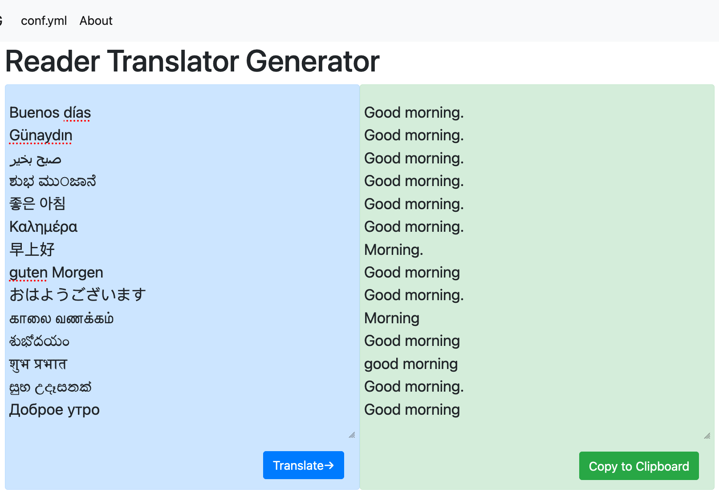
500-Eng : Pretrained Models, Data, Demo
http://rtg.isi.edu/many-eng/
Also available for download from docker
$ IMG= tgowda/rtg-model:500toEng-v1
$ docker run -p 6060:6060 $IMG
# For GPU support, add: --gpus '"device=0'"
RTG Web Interface: REST API behind the scenes (via AJAX)
See also,
Apache Tika integration: https://cwiki.apache.org/confluence/display/TIKA/NMT-RTG
Spanish translation: https://www.ibidemgroup.com/edu/traduccion-machine-translation-datos-modelos/

Slide 55
Translation Service: BLEU on OPUS-100 Test Set
Notes:
4x more languages. the performance is comparable, sometimes better than more sophisticated models; Zhang et al has deep model of 24 layers, with language aware layer norm, layer transform, robust backtranslation etc...
A few cases where our model has poor performance is due to test sets having short sentences; since we are not informing a source language, short sentences, especially single words and phrases without context can be confusing to this 500-Eng multilingual model
It is competitive with the best known results on these test sets

Slide 56
Finetuning: BLEU on IARPA MATERIAL Datasets (Analysis)
“Previous best” : the best bilingual models used in evals; separate for each language

Slide 57
Finetuning: MacroF1 on IARPA MATERIAL Evaluations (Analysis)
“Previous best” : the best bilingual models used in evals; separate for each language
Notes:
“Previous best” is the one we have used during evaluation; the best among dozens of models we have for each language.

Slide 58
Part-III Conclusion
Related Work
Summary
Google: 108, Microsoft: 103 They support many-to-many
OPUS 100, Facebook AI Research : 100 langs Many-to-Eng and Eng-to-Many
Tatoeba Challenge ~500 languages dataset from OPUS; Mostly bilingual models
Standardization of datasets
Tools: RTG, NLCodec, MTData
First ever 500-English multilingual model
Translation service: available for free via docker
State-of-the-art on low resource languages, via finetuning on a limited quantity of data

Slide 59
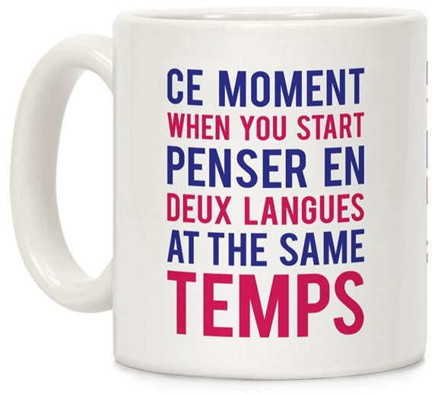
Part-IV Robustness to Language Switching
Improving Multilingual Machine Translation Robustness via Data Augmentation
(Under review for NAACL 2022)
Thamme Gowda, Mozhdeh Gheini, and Jonathan May.

Slide 60
Problem
Sometimes,
Multilingual speakers switch between languages
Part of text is already in target language
Sentences are not correctly segmented
Are the current multilingual NMT models robust? No
How to
Check robustness?
Improve robustness?
Image Credit: Amazon US/Funny Quotes Mugs
Original (Kan+Hin) | bandaaginda bari bageeche ke bahar-e iddivi. kahaani ke andhar bandu bidona. kaam bolo, saab.
English Translation | From the time I've reached, we’ve stayed outside the topic. Let’s get into the story. Tell me the work, sir.
Example of language switching Kannada+Hindi

Slide 61
Robustness Checks
Ribeiro et al 2020^{[1]} proposed behavior testing for NLP in general
Simple modifications of test sets; negation, synonym, NER replacement, etc,
Tasks: sentiment analysis, duplicate question detection, span detection
They have not addressed MT task; their modifications are not trivial in MT task
But the idea of behavior testing for MT is interesting
Proposal: Create more Tests by concatenating test sentences
C-SL: consecutive same language
C-TL: consecutive target language
C-XL: consecutive cross-language
R-XL: random cross-language
[1] https://aclanthology.org/2020.acl-main.442/

Slide 62
Experiment Setup
Workshop on Asian Translation 2021 MultiIndic Task
10 Indian languages → English
Bengali, Gujarati, Hindi, Kannada, Malayalam, Marathi, Oriya, Punjabi, Tamil and Telugu
Training data:
Limited quantity in-domain data
All-data having out-of-domain data (larger)
Dev and test sets are from WAT21
More held-out sets are created as per previous slide (robustness checks)
Training data augmentations:
Concatenation: CatRepeat, CatSL*, CatXL* NOTE: space char between joins *: random sentences, SL: same language, XL: cross language
Noise: DenoiseTarget, NoisySource What noise? 10% of random word drop, replacement and word order shuffle

Slide 63
Results: BLEU
Improvements are not visible on the original (Avg) set, but proposed checklist sets showcase it

Slide 64
Qualitative Examples
Source | আগামী ২০২২ সালের মধ্যে এই কাজ সম্পূর্ণ করার লক্ষ্যমাত্রা স্থির হয়েছে। પ્રધાનમંત્રીએ જણાવ્યું કે સરકાર સ્પષ્ટ લક્ષ્યો અને સમયસૂચકતા સાથે અનેક યોજનાઓ પર કામ કરી રહી છે.
Reference | He said the aim is to complete this task by 2022. The Prime Minister said that the Government is working on various schemes with clear targets and timelines.
Baseline | He said the Government is working on several schemes with clear objectives and timelines.
B+CatRepeat | The target is to be completed by 2022, the Prime Minister said that the Government is working on several schemes with clear targets and timelines. is the of of of of of of of of of of of of of
B+CatXL | The target is to complete it by 2022. The Prime Minister said that the Government is working on a number of schemes with clear targets and timelines.
B+CatSL | We have set a target to complete this task by 2022. The Prime Minister said that the Government is working on a number of schemes with clear objectives and timelines.
B+NoisySrc | The Prime Minister said that the Government is working on several schemes with clear objectives and timelines.
B+DenoiseTgt | He said the Government is working on several schemes with clear objectives and timelines.
B+CatXL +DenoiseTgt | We have set a target of completing it by 2022. The Prime Minister said that the Government is working on a number of schemes with clear targets and timelines.
Example translations from models trained on all-data

Slide 65
Attention Visualization
Baseline
Model with augmented data (CatXL+Denoise)
Models trained with augmented data learns better cross-attentions

Slide 66
Attention Bleed
Cross-attention mass crossing sentence boundaries in concatenated test sentences
Lower is better
Average attention bleed across
All sentences
Transformer layers
Attention heads
Models trained on augmented sentences achieve lower bleed ➔ Learn better attention
Attention bleed in models trained on all-data

Slide 67
Part-IV Conclusion
Related Works
Summary
Back translation: Costly in massively multilingual setup
Most other robustness works are concerned about bilingual MT, and noisy data
Current multilingual MT models are not robust to language switching
Proposed robustness checks
Investigated augmentation methods to improve robustness
Models trained with sentence concatenation and denoising achieve
Best scores on robustness tests
Learn better attention mechanisms

Slide 68
Current/WIP Research
[WIP] Combine Part-III and Part-IV:
Robustness across 500+ multilingual NMT In part-III, we used dataset from WAT21 shared task
[WIP] Part-III revised:
+100 more languages (Up to 600 languages)
More datasets have been found on web and included in mtdata

Slide 69
Implications
 | Before | After
NMT Architecture | Autoencoder: i.e., Encoder-Decoder | Autoregressor + Classifier ^{[1]}; more emphasis on the target vocabulary and data imbalance
Vocabulary Size | Did not know why some are best; Arbitrarily chosen or via grid search for each dataset | Heuristic to auto adjust vocab size! Byte pair-encoding (BPE) size is chosen to minimize sequence lengths and improve class balance ^{[1]}
Evaluation Metrics | Treat each ‘token’ equally; Stopwords have more weight | Treat each ‘type’ equally ^{[2]}; All types have equal weight. Address data imbalance at evaluation
Scaling NMT | To ~100 languages | To ~500 languages ^{[3]} Bunch of useful tools, datasets; Standardization of dataset IDs
Multi-lingual lang. switching | Not robust | Robust to language switching ^{[4]} Can translate text that start in one language and finishes in another. Robustness to partly translated text
[1] Gowda and May, ‘Finding the optimal vocabulary size for NMT’, EMNLP 2020 Findings
[2] Gowda et al, ‘Macro-average: Rare types are important too’, NAACL 2021
[3] Gowda et al, ‘Many-to-English tools, data, and pretrained models’, ACL 2021 Demos [4] Gowda et al, ‘Improving multilingual MT robustness via data augmentation, [under review/NAACL2022]
TG's Dissertation Proposal

Slide 70
Works Outside MT [Since MS @ USC]
These projects helped in shaping some of the ideas and skills for PhD work!
Mehrabi, N., Gowda, T., Morstatter, F., Peng, N., & Galstyan, A. (2020, July). Man is to person as woman is to location: Measuring gender bias in named entity recognition. In Proceedings of the 31st ACM Conference on Hypertext and Social Media (pp. 231-232).
Pan, X., Gowda, T., Ji, H., May, J., & Miller, S. (2019, November). Cross-lingual joint entity and word embedding to improve entity linking and parallel sentence mining. In Proceedings of the 2nd Workshop on Deep Learning Approaches for Low-Resource NLP (DeepLo 2019) (pp. 56-66). Wagstaff, K., Francis, R., Gowda, T., Lu, Y., Riloff, E., Singh, K., & Lanza, N. (2018, April). Mars Target Encyclopedia: Rock and Soil Composition Extracted from the Literature. In Proceedings of the AAAI Conference on Artificial Intelligence (Vol. 32, No. 1).
Gowda, T., Hundman, K., & Mattmann, C. A. (2017, June). An approach for automatic and large-scale image forensics. In Proceedings of the 2nd International Workshop on Multimedia Forensics and Security (pp. 16-20).
Wagstaff, K. L., Lu, Y., Stanboli, A., Grimes, K., Gowda, T., & Padams, J. (2018, April). Deep Mars: CNN classification of mars imagery for the PDS imaging atlas. In Thirty-Second AAAI Conference on Artificial Intelligence.
Hundman, K., Gowda, T., Kejriwal, M., & Boecking, B. (2018, December). Always lurking: understanding and mitigating bias in online human trafficking detection. In Proceedings of the 2018 AAAI/ACM Conference on AI, Ethics, and Society (pp. 137-143). Gowda, T., & Mattmann, C. A. (2016, July). Clustering web pages based on structure and style similarity (application paper). In 2016 IEEE 17th International conference on information reuse and integration (IRI) (pp. 175-180). IEEE.
Mattmann, C. A., Yang, G. H., Manjunatha H., Gowda, T., Zhou, A. J., Luo, J., & McGibbney, L. J. (2016). Multimedia metadata-based forensics in human trafficking web data.
Bias in ML models
IE / NER
Image Classification
Scaling up
Web Data Mining

Slide 71
Next Steps in Ph.D.
Ph.D. requirements: 60/60 ✅
[02/28] Currently under-review paper publication
[02/28] Finish dissertation draft
[03/15?] Review the draft with committee members and address comments
[March?] Dissertation defense
Submit manuscript to grad school
[02/15] Many-English v2 (Robustness across 500+100 languages)
USC deadlines:
Spring 22 : 03/18
Summer 22 : 07/01

Slide 72
Q & A
The Inevitable Problem of Rare Phenomena Learning in Machine Translation
Dissertation Proposal
by
Thamme Gowda
Committee
Jonathan May (advisor)
Chris Mattmann
Xuezhe Ma
Aiichiro Nakano
Shri Narayanan
Xiang Ren

Slide 73
The Other Curse
“The more of the local stuff we get right, the more users will come to trust the software, and hence the more noticeable long-range dependencies will become, and the more upset people will get if they are deceived by a wrong analysis” – Mark Steedman, 2008

Slide 74
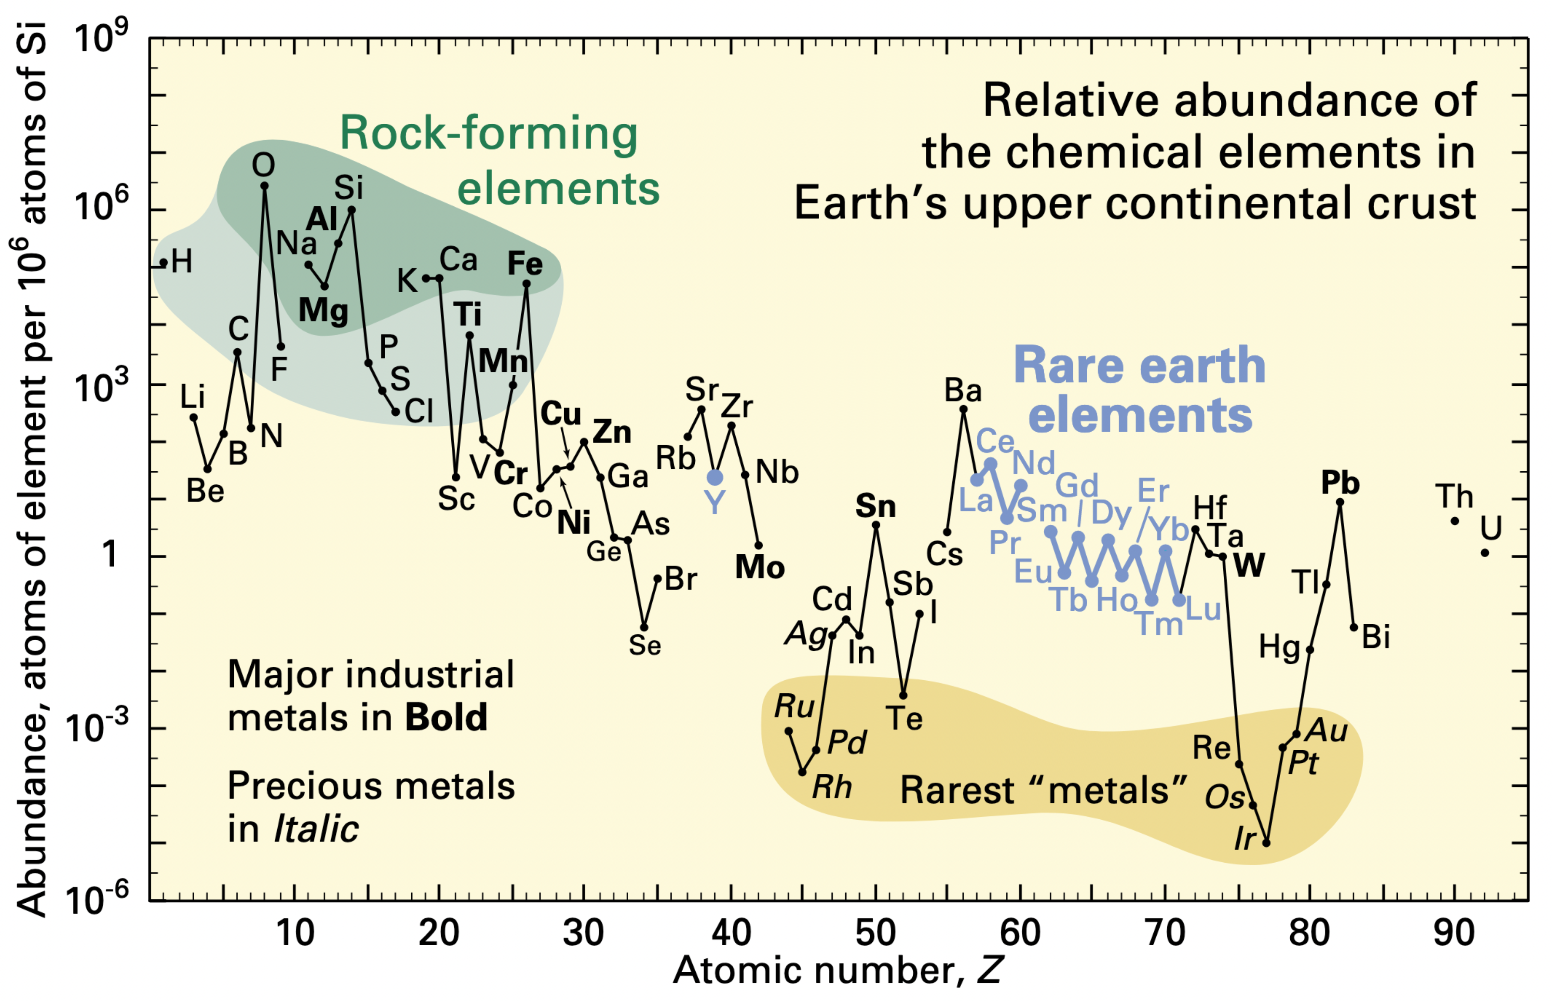

Q & A
Closing thought: Rare/precious/novel observations are statistically indistinguishable from noise
Rare = abnormal (/noise?)
Geology: Rarest inert metals are precious
Image Credit: U.S. Geological Survey Fact Sheet 087-02 https://pubs.usgs.gov/fs/2002/fs087-02/

Slide 75
Background
Zipfian distribution of word types head: a few types have a lot of tokens long-tail: a lot of types have only a few tokens each
Notes:
e.g., Brown corpus (English): 46.5% tokens from top 50 types 90% % tokens from 6000 types; and 95.45% are from 14.5k types

Slide 76
Thesis Statement
Machine translation (MT) is not yet a solved problem.
Only about a hundred languages are supported at best; thousands more are currently unsupported
Even for the languages that are already supported, the translations are far from being perfect
In any natural language system, a long-tailed word-type distribution is inevitable in which the vast number of types occur only rarely. Machine learning techniques such as the neural machine translation (NMT) stutter (and sometimes hallucinate) on such rare phenomena. In this proposal, I will discuss my efforts towards addressing these challenges:
The inevitable long-tail curse: Most of the information of a language system is in rare words, but these high information “rare” words have only a few, and often zero, training examples to learn from. While completely resolving this curse may be impossible, I’ll show that it is possible to mitigate the severity by adjusting a few hyperparameters during the modeling phase.
Rare words are important too: I show that widely used MT evaluation metrics do not address the inevitable imbalance in word type distributions. As a result, they place more emphasis on stopwords and overlook rare words. I propose using a simple metric that addresses word type imbalance, and show that it is effective in direct assessment as well as indirect evaluation on downstream tasks.
Scaling NMT to 500 languages: I discuss my efforts to expand MT support to low-resource languages currently unsupported by others. I showcase a single NMT model that can translate from 500+ languages to English.
Robustness of multilingual NMT: Multilingual speakers can and do seamlessly switch languages, whereas multilingual machine translators, as built currently, are not robust to such sudden changes. I propose techniques to measure and improve the robustness to language switching of multilingual translators.

Slide 77

Class Performance
Let $T=\left\{ \left(h^{\left(i\right)},y^{\left(i\right)}\right) \right| i=1,2,3, …m\}$be a test set with m records of (hypothesis, reference), respectively
Let $C(c, a)$ counts the number of tokens of type c in sequence a
$\text{Preds}\text{(}\text{c}\text{) }= \sum_{i=1}^{m}{C(c, h^{(i)})}$
$\text{Refs}\text{(}\text{c}\text{)} = \sum_{i=1}^{m}{C(c, y^{(i)})}$
$\text{Match}\text{(}\text{c}\text{)}= \sum_{i=1}^{m}{min⁡\{C\left(c, h^{\left(i\right)}\right), C(c, y^{(i)})}\}$
Precision, $P_{c}= \frac{Match\left(c\right)}{Preds\left(c\right)}$ Recall, $R_{c}= \frac{Match\left(c\right)}{Refs\left(c\right)}$

Slide 78
WebNLG Data-to-Text Evaluation
Correlation with Fluency, Grammar, and Semantics on English only
MacroF1 is a poor indicator of Fluency + Grammar, but one of the strong indicators of Semantics

Slide 79
MacroF1 for ASR Evaluation
Which ASR metric is the best indicator of downstream CLIR task performance?
Word error rate (WER)
Match error rare (MER)
Word information preserved (WIP)
Other metrics: BLEU, MicroF1, MacroF1
Correlation between ASR metrics and AQWV
Using Kendall’s rank coefficient, 𝜏
➔MacroF1 is a strong indicator, on Pashto (2C) (with over 99% confidence)
Notes:
Just show 2C; make a viz
And remove others – say not enough samples
Give us your ASR outputs on analysis?

Slide 80
Transfer Learning: Fine Tuning
E.g., two low-resource languages BRE: 1.2M ENG toks SME: 100K ENG toks
Huge improvements in BLEU!
Model | BRE-ENG | SME-ENG
Baseline | 12.7 | 10.7
500-eng parent | 11.8 | 8.6
Finetuned | 22.8 | 19.1

Slide 81

Classifier Evaluation
Test set, $T=\left\{ \left(h^{\left(i\right)},y^{\left(i\right)}\right) \right| i=1,2,3, …m\}$ of (hypothesis, reference)
Classes are the word types, after tokenization
We use the same tokenizer as BLEU, as implemented in SacreBLEU
$C(c, a)$ counts the number of tokens of type c in sequence a
$\text{Preds}\text{(}\text{c}\text{) }= \sum_{i=1}^{m}{C(c, h^{(i)})}; \text{Refs}\text{(}\text{c}\text{)} = \sum_{i=1}^{m}{C(c, y^{(i)})}$
$\text{Match}\text{(}\text{c}\text{)}= \sum_{i=1}^{m}{min⁡\{C\left(c, h^{\left(i\right)}\right), C(c, y^{(i)})}\}$ [BLEU, Papineni et al 2002]
Precision, $P_{c}= \frac{Match\left(c\right)}{Preds\left(c\right)}$ ; Recall, $R_{c}= \frac{Match\left(c\right)}{Refs\left(c\right)}$
F-measure per class c: $F_{β;c}={\left(1+β\right)}^{2} \frac{P_{c} × R_{c}}{β^{2} ×{ P}_{c}+R_{c}}$
Notes:
How do we evaluate Classifiers?
We take a test set,
tokenize it -- word types are our classes
Similar to BLEU, we compute match based on predictions, references, and common
Then we compute Precision, the same way as BLEU.. But the difference here is BLEU computes one precision for all unigrams, it doesn't compute precision for each class or type, e.g. it doesnt tell whats the precision for type ‘the’ , but we do... we compute for each type from reference and hypothesis Similarly, we compute recall for each type
And then F-measure for each type
We are all doing this for evaluating classifiers

